Slide 1
A complete guide to programming in c++
Chapter 1

Slide 2
Fundamentals of c++
In this chapter, the fundamental characteristics of the object-oriented C++ programming language will be described and the necessary steps for creating a fully functioning C++ program will be shown
Basic structure of a C++ program will also be discussed

Slide 3
Historical perspective
C++ was created by Bjarne Stroustrup and his team at Bell Laboratories (AT&T, USA) to help implement simulation projects in an object-oriented and efficient way.
C++ was derived from C and was at the earliest development just called “C with classes”
In 1989 an ANSI Committee (American National Standards Institute) was founded to standardize the C++ language. The aim was to have as many compiler vendors and software developers as possible agree on a unified description of the language in order to avoid the confusion caused by variety of dialects
In 1998 the ISO (international Organization for Standardization) approved a standard for C++

Slide 4
Characteristics of c++
C++ is not a purely object-oriented language but a hybrid that contains the functionality of the C programming language. This means that you have all the features that are available in C:
Universally usable modular programs
Efficient, close to the machine programming
portable programs for various platforms

Slide 5
Characteristics of c++
The large quantities of existing C source code can also be used in C++ programs. C++ supports the concepts of object-oriented programming (or OOP for short), which are:
data abstraction, that is, the creation of classes to describe objects
data encapsulation for controlled access to object data
inheritance by creating derived classes (including multiple derived classes)
polymorphism (Greek for multiform), that is, the implementation of instructions that can have varying effects during program execution

Slide 6
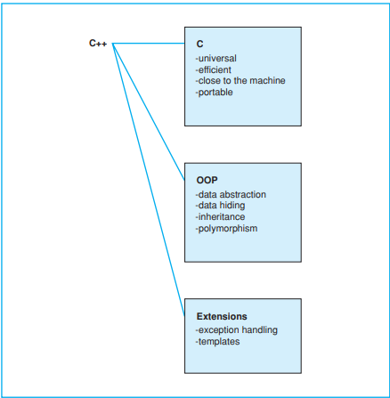
Characteristics of c++

Slide 7
Traditional Procedural Programming
In traditional, procedural programming, data and functions (subroutines, procedures) are kept separate from the data they process. This has a significant effect on the way a program handles data:
the programmer must ensure that data are initialized with suitable values before use and that suitable data are passed to a function when it is called
if the data representation is changed, e.g. if a record is extended, the corresponding functions must also be modified.
Both points can lead to errors and neither support low program maintenance requirements

Slide 8
Object-Oriented programming
Object-oriented programming shifts the focus of attention to the objects, that is, to the aspects on which the problem is centered. A program designed to maintain bank accounts would work with data such as balances, credit limits, transfers, interest calculations, and so on.
An object representing an account in a program will have properties and capacities that are important for account management. OOP objects combine data (properties) and functions (capacities).
A class defines a certain object type by defining both the properties and the capacities of the objects of that type. Objects communicate by sending each other “messages,” which in turn activate another object’s capacities.

Slide 9
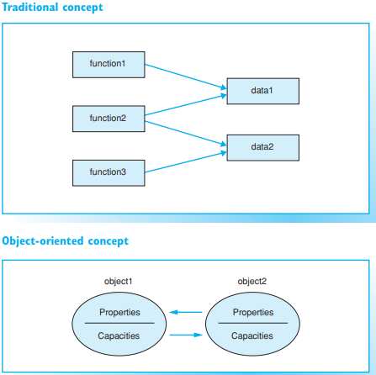
Traditional vs OOP concept

Slide 10
Advantages of OOP
Object-oriented programming offers several major advantages to software development:
reduced susceptibility to errors: an object controls access to its own data. More specifically, an object can reject erroneous access attempts
easy re-use: objects maintain themselves and can therefore be used as building blocks for other programs
low maintenance requirement: an object type can modify its own internal data representation without requiring changes to the application.

Slide 11
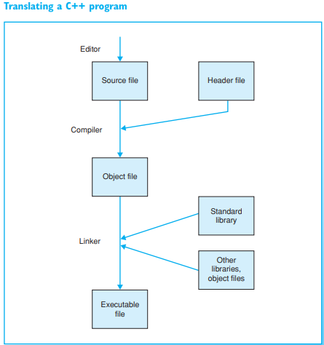
Developing a C++ program
The following three steps are required to create and translate a C++ program:
1. First, a text editor is used to save the C++ program in a text file. In other words, the source code is saved to a source file. In larger projects the programmer will normally use modular programming. This means that the source code will be stored in several source files that are edited and translated separately.
2. The source file is put through a compiler for translation. If everything works as planned, an object file made up of machine code is created. The object file is also referred to as a module.
3. Finally, the linker combines the object file with other modules to form an executable file. These further modules contain functions from standard libraries or parts of the program that have been compiled previously.

Slide 12
Important information
It is important to use the correct file extension for the source file’s name. Although the file extension depends on the compiler you use, the most commonly found file extensions are .cpp and .cc.
Prior to compilation, header files, which are also referred to as include files, can be copied to the source file. Header files are text files containing information needed by various source files, for example, type definitions or declarations of variables and functions. Header files can have the file extension .h, but they may not have any file extension.
The C++ standard library contains predefined and standardized functions that are available for any compiler.
Modern compilers normally offer an integrated software development environment, which combines the steps mentioned previously into a single task. A graphical user interface is available for editing, compiling, linking, and running the application. Moreover, additional tools, such as a debugger, can be launched

Slide 13
Troubleshooting
If the source file contains just one syntax error, the compiler will report an error. Additional error messages may be shown if the compiler attempts to continue despite having found an error. So, when you are troubleshooting a program, be sure to start with the first error shown.
In addition to error messages, the compiler will also issue warnings. A warning doesnot indicate a syntax error but merely draws your attention to a possible error in the program’s logic, such as the use of a non-initialized variable.

Slide 14
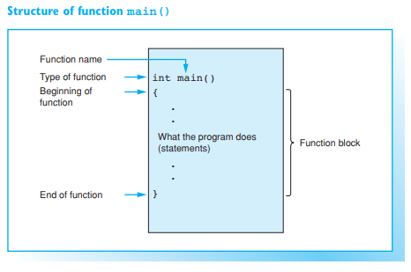
Sample Program

Slide 15
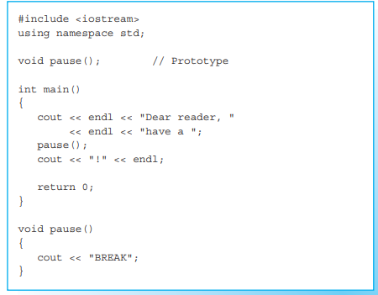
Exercises
Exercise 3: What does the C++ program output on screen?

